Slide 1


🤠 HowdyLang Syntax Guide
Howdy, partner! Welcome to HowdyLang — a string-based, down-home programming language inspired by the heart of Texas. This here guide to the language's grammar, its cowboy-lingo-flavored syntax, and how to wrangle your logic with it.
Whether you're HOLLERin' or loopin' WHILE_YALL, we've got you covered, Yeehaw!!

Slide 2




📜 Program Structure
Top-to-Bottom Execution
Statements Enclosed
It's a Script
HowdyLang programs execute statements in order, from the first line to the last.
Every program lives between MAKE_PROGRAMMING and GREAT_AGAIN tags.
Every HowdyLang program is a script made up of one or more statements enclosed in MAKE_PROGRAMMING and GREAT_AGAIN, executed in order from top to bottom.
MAKE_PROGRAMMING
username = "Cowboy";
HOLLER "Howdy, " username;
GREAT_AGAIN

Slide 3
HowdyLang Design Principles
No Explicit Typing: All values are strings, simplifying the syntax for new learners.
Expressive Keywords: Cowboy lingo like HOLLER adds personality, making syntax memorable.
Java/JavaCC Backend: Utilizes Java and JavaCC for robust parser construction and AST practice.
Flexible Whitespace: No strict formatting rules allow users to write code freely.

Slide 4


🤠 Statement Types
Variable Assignment
Assignment Operators
Assign values using down-home Texan phrases. Only strings or identifiers allowed!!
Use =, <-, is, are, contains, or contain. They all have the same functionality
For User friendly use cases — the following assignment operators are allowed:
=
<-
is
are
contains
contain
name = "Buck";
hat <- "Stetson";
boots is "snakeskin";

Slide 5




🖨️ Printing
HOLLER Command
Use HOLLER to print messages.
Print Variables
HOLLER can also print variable contents.
Multiple Values
Combine several values in one HOLLER.
Use HOLLER to print messages or variables.
HOLLER "Howdy partner!";
HOLLER "Name: " name;
Multiple values can be printed in one Print Statement.

Slide 6
🔀 Conditional Logic
IF_YALL
Equality Operators
Make decisions with IF_YALL. An optional ELSE_YALL handles other cases.
Use ==, equals, or equal to check conditions. They're all good!
Use IF_YALL to branch your logic — with optional ELSE_YALL.
IF_YALL (name == "Buck")
{ HOLLER "That's Buck!"; }
ELSE_YALL
{ HOLLER "Who’re you?"; }
HowdyLang can also used by friendly equality expressions:
IF_YALL (role equals "rancher")
Allowed equality operators:
==
equals
equal

Slide 7


🔁 Loops
WHILE_YALL
DO_YALL ("N") TIMES
Keep goin’ till the cows come home. The block runs as long as your condition is true.
Do it N times, no more, no less. Provide the number as a quoted string.
1. WHILE_YALL — Keep goin’ till the cows come home:
count = "start";
WHILE_YALL (count == "start")
{ HOLLER "Still startin’..."; count = "done"; }
=> Executes the block as long as the condition holds.
2. DO_YALL ("N") TIMES — Do it N times:
DO_YALL ("3")
TIMES { HOLLER "This here’s a loop!"; }
=> The number must be provided as a quoted string (e.g. "5").

Slide 8
📦 Block Statements
Group 'Em Up
Conditional Blocks
Single Statement Option
Use curly braces { } to group several statements. This keeps your code neat.
Commonly used with IF_YALL for conditional execution of multiple lines.
If you only have one statement, braces aren't needed!
Or use { } to group multiple statements:
IF_YALL (mode == "debug")
{ HOLLER "Debuggin’"; HOLLER "Watch out!"; }

Slide 9
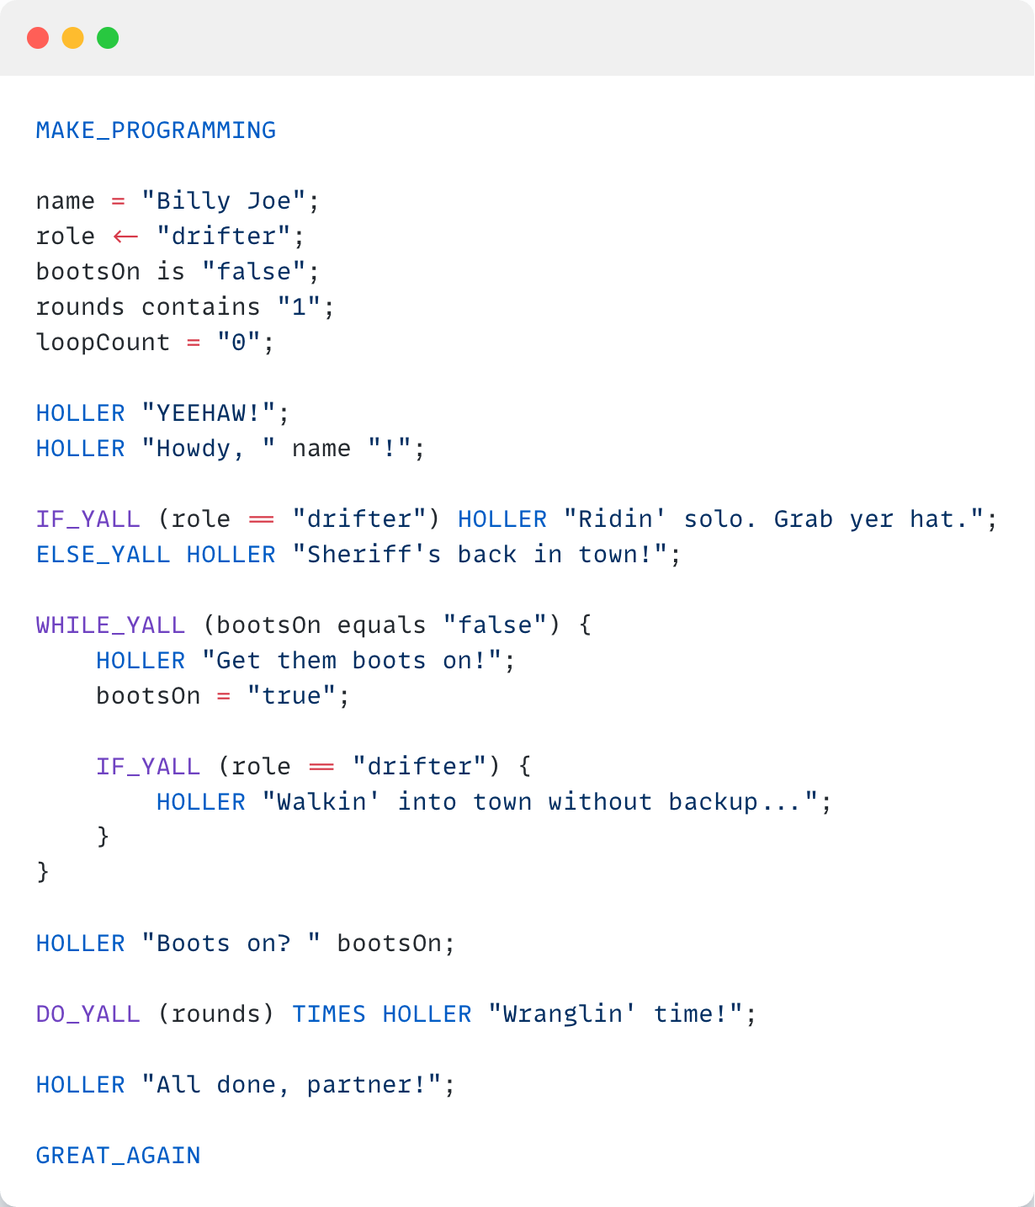




HowdyLang Sample Script
It demonstrates fundamental programming concepts in action.
Variables & Assignment
Shows declaration and assignment using '=', '<-', 'is', 'contains'.
Conditional Logic
Explores IF_YALL and ELSE_YALL for branching.
Looping Constructs
Features WHILE_YALL and DO_YALL for repetition.
String Operations
Demonstrates string equality checks and printing.

Slide 10

Result
YEEHAW!
Howdy, Billy Joe!
Ridin' solo. Grab yer hat.
Get them boots on!
Walkin' into town without backup...
Boots on? true
Wranglin' time!
All done, partner!

Slide 11
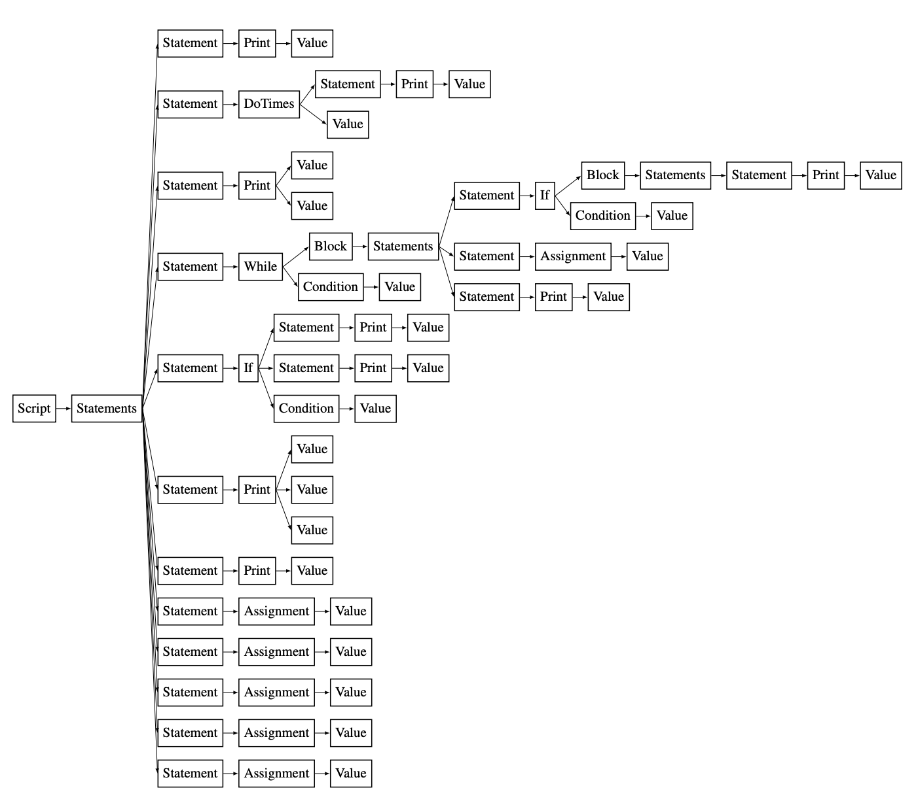
🌲 Parsing Tree Explanation
Every HowdyLang script transforms into a structured tree.
This parsing tree reveals the code's underlying hierarchy.

Slide 12

Conclusion
HowdyLang is a creative and expressive language designed to teach core programming concepts using a thematic syntax. Through this project, we successfully:
Designed a formal grammar and implemented a custom parser in JavaCC
Built an AST-based interpreter and translator to Java
Demonstrated all required language features with themed syntax
Presented a full development and execution pipeline

